Slide 1

Thermal management materials
Unit 6-4
diamond-based composites
Notes:
By combination of specific inherent properties of metals and ceramics, ideally, the properties of MMCs can be tailored to the requirements of particular applications by proper selection of the constituent phases. However, this approach is not always straight forward as just combining a highly conductive metal such as Al or Cu with the highest thermal conductivity and low CTE materials such as diamond or graphite will not necessarily lead to a new material with improved thermo-physical properties. The key issues in successful development of MMCs are the understanding and control of the formation of the interface (microstructure) between the individual constituent phases. In this respect the interrelationship between processing conditions and chemical compatibility of the phases involved is of prime concern. The interface formation in MMCs governs bonding (adhesion) between reinforcement and matrix as well as the efficiency of heat transfer between both phases and, thus, the overall thermophysical properties of MMCs, particularly thermal expansion and thermal conductivity.

Slide 2
Composites for thermal management
Topics Diamond composites
- effect of the volume fraction
- effect of the particle size
- effect of the interfacial thermal resitance
- effect of matrix alloying
- effect of stress
- effect of thermal cycling
Goals - understand the principles of thermal properties of composite materials, i.e. design of composites with tailored thermal properties and interfaces

Slide 3


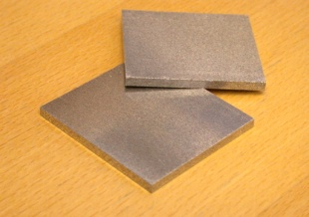


Aluminium composites for electronic applications
Microelectronics:
Server for large scale data processing
Higher clock rates and miniaturi-zation of transistors lead to higher power density in micro-processors
Opto-electronics:
Diode laser for manufacturing, laser pumping and medicine application
Higher power density and stability of laser beam is limited by efficient heat transfer
Power electronics:
Power converters (IGBT) for energy distribution
Size reduction and higher currents in power converters drive thermal conductivity of base plates
Notes:
In Mikroelektronik- und Halbleiter-Komponenten verursachen die stetig zunehmenden Leistungsdichten einen derart starken Anstieg der thermischen Belastung, dass die kritische Temperaturgrenze gewisser Halbleiter-Komponenten bereits erreicht ist; demzufolge muss die Wärme effizienter abgeführt werden. Dies erfolgt über das Substrat, auf welchem die Mikroelektronik- und Halbleiterkomponenten aufgebaut werden.
Als typisches Beispiel sei an dieser Stelle das „IGBT-Modul" genannt; vereinfacht ausgedrückt handelt sich hierbei um einen Spannungsmodulator, wie er unter anderem in elektrischen Zügen oder Strassenbahnen, aber auch vermehrt in Elektro-/Verbrennungsmotor-Hybridfahrzeugen zum Einsatz kommt. Im IGBT-Modul werden die Elektronik-Komponenten auf eine Grundplatte aufgelötet, wobei eine elektrische Isolation aus Keramik (AlN oder Al₂O₃) als Zwischenschicht eingebaut wird. Zur Vermeidung thermischer Ermüdung in der Lotverbindung muss diese Grundplatte einen der keramischen Isolation möglichst nahen WAK aufweisen und gleichzeitig in der Lage sein, die Wärme möglichst effizient abzuleiten, zu verteilen und schließlich an den angeflanschten Kühler weiterzuleiten; deshalb wird sie auch "heat spreader" (Wärmespreizer) genannt. Diese Anforderungen werden von Al/SiC PRM vorbildlich erfüllt; sie konkurrieren in diesem Bereich zunehmend mit den bisher verbreiteten Cu-, Cu/Mo- oder Cu/W-Werkstoffen.

Slide 4
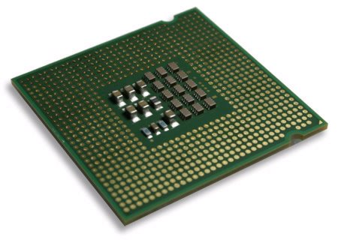
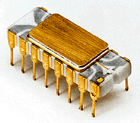
Increase of power density in microelectronics (Moore's law)
10000
Rocket
Irwin&Vijay, PSU, 2002
CSE477 L01 Introduction.<number>
Nozzle
1000
Nuclear
100
Reactor
Power Density (W/cm²)
8086
10
4004
Hot Plate
P6
8008
8085
Pentium® proc
Courtesy, Intel
386
8080
286
486
1
1971
1 MHz / 2250 transistors
Intel 4004
2005
>3.5 GHz / >40 Mio. transistors
Intel Pentium 4 Extreme Edition
1970
1980
1990
2000
2010
Year
further progress in microelectronics miniaturization requires new thermal management materials
Courtesy, Intel
Notes:
motivation
Ever increasing power densities impose enhanced heat dissipation capability in electronic devices ; this is the driving force for the development of new heat spreaders and heat sinks materials with dramatically improved thermophysical properties.
Materials of high thermal conductivity are needed for the conduction of heat for the purpose of heating or cooling. One of the most critical needs in the electronic industry. Due to the miniaturization and increasing power of microelectronics, heat dissipation is key to the reliability, performance and further miniaturization of microelectronics.
“… it has been estimated that, by the year 2010, a single computer chip will hold a billion transistors generating 1000 watts of power; this is more heat per surface unit than that of a nuclear reactor …" [Johnson G., The New York Times, 2002]
- power density in microelectronics too high to keep junctions at low temperature
- the progress in microelectronic miniaturization and performance is limited by the availability of suited thermal management materials

Slide 5
materials requirements for (micro)electronic applications
- Thermal conductivity: ≥ 600 W/mK
- Coefficient of thermal expansion: 4 - 7·10⁻⁶/K
- Isotropic properties
there are no monolithic material to fulfill these requirements
there is a need for “new“ materials with tailored properties
Notes:
Ever increasing power densities impose enhanced heat dissipation capability in electronic devices ; this is the driving force for the development of new heat spreaders and heat sinks materials with dramatically improved thermophysical properties.

Slide 6
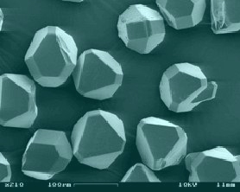
Materials Selection
target
approach: Al/diamond composites
Al/SiC/60_{p}
(state of the art)
Notes:
Materials of high thermal conductivity are needed for the conduction of heat for the purpose of heating or cooling. One of the most critical needs in the electronic industry. Due to the miniaturization and increasing power of microelectronics, heat dissipation is key to the reliability, performance and further miniaturization of microelectronics. The heat dissipation problem is so severe that even expensive thermal conductors such as diamond, carbon-based materials and MMCs are being used in high-end microelectronics. Due to the low coefficient of thermal expansion (CTE) of semiconductor chips and their substrates, heat sinks also need to have low CTE.
Approach:
Integrate high thermal conductivity, low thermal expansion filler material particles (diamond !) in a highly thermally conductive metallic matrix such as Al or Cu.
Monocrystalline diamond has the highest isotropic thermal conductivity of any known material; this makes it the ideal filling material for metal matrix composites featuring high thermal conductivity. Such composites are required for heat spreading in micro- and powerelectronic devices, but are not available yet. One of the major reasons is that the outstanding thermophysical properties of diamond can only be exploited to the whole extent when an optimal interface between the diamond crystals and the metal matrix is obtained. High interfacial bonding and minimum thermal boundary resistance are the most important issues in this regard.

Slide 7
Prediction of Thermal Conductivity for Particle Reinforced Composites
Maxwell
Hasselman & Johnson
with
and
B: Biot-number
1/h: thermal interface resistance
(h: thermal interface conductance)
a: particle radius
λ thermal conductivity
v_{r} volume fraction of reinforcement
m matrix (subscript)
c composite (subscript)
D.P.H.Hasselman and Lloyd F.Johnson, Journal of composite materials, Vol. 21, June 1987, 508-515
Notes:
If B tends towards zero, i.e. for large values of h and a, the Hasselman-Johnson equation transforms back into the Maxwell equation.
If B is large, i.e. for small h and a, the composite thermal conductivity decreases with increasing v_{r}, regardless of R.
On the other hand if R tends towards zero, the composite thermal conductivity approaches the conductivity of the matrix with spherical pores; in this case the effect of interface thermal resistance and reinforcement diameter on the composite thermal conductivity disappears.

Slide 8
Thermal Conductivity Prediction of Al-diamond-MMCs
using the Hasselman - Johnson Equation
effect of diamond particle size
Al99.99/diam.
gas pressure
infiltration
h = 1.8·10⁸ W/m²K
Ideal material
Assumptions:
matrix Al 99.99
λ_{matrix} = 237 W/mK
λ _{Diamond} = 1800 W/mK
d _{Diamond} = variable
V_{d} = 60%
600 μm
200 μm
60 μm
Al 99.99
20 μm
6 μm
2 μm
courtesy S.Kleiner

Slide 9
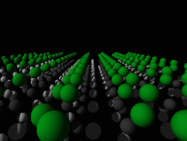
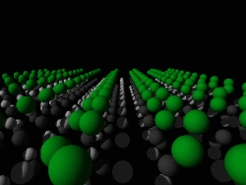

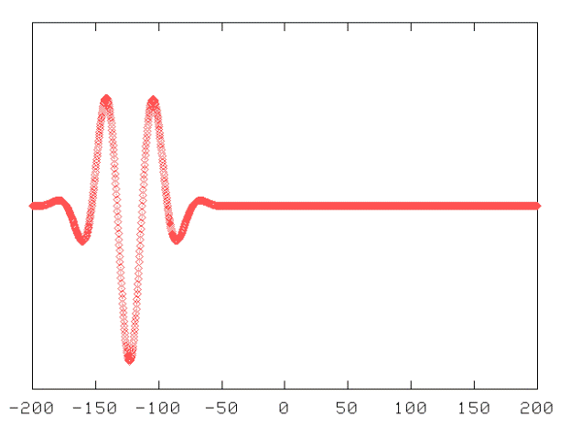
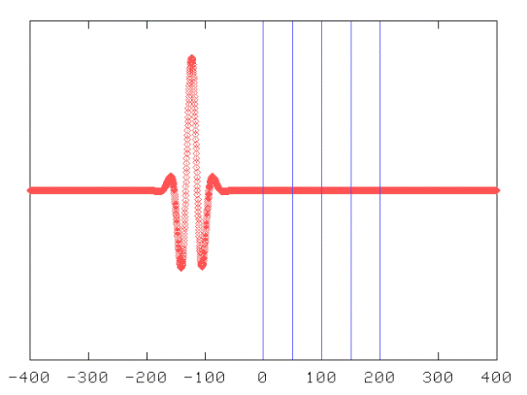
Origin of the Interfacial Thermal Resistance
Source: www.physik.tu-berlin.de/institute/IFFP/richter/new/research/surface-phonons.shtml
interface
large particles
small particles
Source: phillpot.mse.ufl.edu

Slide 10
Thermal Conductivity Prediction of Al-diamond-MMCs
using the Hasselman - Johnson Equation
effect of matrix (thermal conductivity)
Assumptions:
λ_{Co} = 69 W/mK
λ_{Al} = 237 W/mK
λ_{Cu} = 400 W/mK
λ_{Ag} = 430 W/mK
λ _{Diamond} = 1800 W/mK
d _{Diamond} = 150 μm
V_{d} = 60%
Ideal material
courtesy S.Kleiner

Slide 11
Thermal Conductivity of Al/SiC – effect of h and a
h_{Al/SiC (Experimental)} = 8·10⁷ -1·10⁸ W/m²K
λ_{r} = 300 W/m·K for SiC
Notes:
Measured values:
Al/SiC_{F100}: 251-252 W/mK
Al/SiC_{F500}: 213-217

Slide 12
Thermal Conductivity Prediction of diamond-MMCs
using the Hasselman - Johnson Equation
assuming h = 8·10⁷ W/m²·K
Cu/diamond, with
a = 50 μm
h = 8·10⁷ W/m²·K
⇒ B = 0.45
?
Al/diamond, with
a = 50 μm
h = 8·10⁷ W/m²·K
⇒ B = 0.45
Al/SiC, with
a = 50 μm
h = 8·10⁷ W/m²·K
⇒ B = 0.08
Al/SiC, with
a = 6.4 μm
h = 8·10⁷ W/m²·K
⇒ B = 0.6
λ_{r} = 300 W/m·K for SiC
1800 W/m·K for diamond

Slide 13
Thermal Conductivity of Cu/diamond Composites
ITR
by courtesy of Netzsch Gerätebau GmbH, D-95088 Selb (Germany)

Slide 14
Thermal Conductivity Analysis of diamond-MMCs
using the Hasselman - Johnson Equation
Cu/diamond, with
a = 50 μm
h = 8·10⁷ W/m²·K
⇒ B = 0.45
Cu/diamond, with
a = 50 μm
h = 1·10⁶ W/m²·K
⇒ B = 36
λ_{r} = 1800 W/m·K for diamond

Slide 15
Notes:
The influence of active element additions in Cu-diamond composites on their thermal conductivity and the coefficient of thermal expansion
L. Weber, R. Tavangar; Laboratory of Mechanical Metallurgy, Institute of Materials
Ecole Polytechnique Fédérale de Lausanne (EPFL), CH-1015 Lausanne, Switzerland
Abstract
Ever increasing requirements for heat dissipation capacity in thermal management of electronic devices have created considerable interest in materials with very high thermal conductivity combined with a tailored coefficient of thermal expansion. Composites of diamond and copper are very promising in this regard yet suffer from inherently weak interaction at the diamond copper interface. To improve this situation active elements have to be added to the copper matrix. Unfortunately, these active elements decrease the intrinsic thermal conductivity of the copper matrix and may build a continuous carbide interlayer at the copper diamond interface that reduces the effective conductivity of the diamond. We present in this contribution a detailed study of the effect of chromium and boron additions to the copper matrix in diamond reinforced composites made by gas pressure infiltration. We screen the range of active element additions in order to study the evolution of the CTE and the thermal conductivity of the composite. We find that the transition from low (120 W/mK) to high (>600 W/mK) thermal conductivity happens at the same active element concentration where the CTE drops from the matrix value (roughly 16 ppm/K), rationalized by weak bonding of the diamonds, to a much lower value, i.e. 10 ppm/K for Cu-Cr and 6.5 ppm/K for Cu-B. The former value is still surprisingly high while the latter is in good agreement with elastic composite theory. We compare the active element concentration at which the transition appears in the two alloying systems with the thermodynamic stability limit of the carbide in contact with the Cu-based melt.
e-mail: ludger.weber@epfl.ch

Slide 16
Thermal Conductivity Potential of Diamond/Al MMCs
λ_{r} = 300 W/m·K for SiC
1800 W/m·K for diamond
Al/diamond, with
a = 50 μm
h = 8·10⁷ W/m²·K
?
Al/SiC, with
a = 50 μm
h = 8·10⁷ W/m²·K
* D.P.H.Hasselman and Lloyd F.Johnson, Journal of composite materials, Vol. 21, June 1987, 508-515
Notes:
Materials of high thermal conductivity are needed for the conduction of heat for the purpose of heating or cooling. One of the most critical needs in the electronic industry. Due to the miniaturization and increasing power of microelectronics, heat dissipation is key to the reliability, performance and further miniaturization of microelectronics. The heat dissipation problem is so severe that even expensive thermal conductors such as diamond, carbon-based materials and MMCs are being used in high-end microelectronics. Due to the low coefficient of thermal expansion (CTE) of semiconductor chips and their substrates, heat sinks also need to have low CTE.

Slide 17
High thermal conductivity Al/diamond MMCs
results on Al/diamond - synthesis feasibility
1. successful synthesis of defect free Al/diamond composites by pressurised liquid metal infiltration
2. preservation of the diamond sp³-structure during composite synthesis
O. Beffort, S. Vaucher, F.A. Khalid, Diamond and Related Materials 13 (2004), 1834-1843
P. Gasser, U.E. Klotz, F.A. Khalid, O. Beffort, Microsc. Microanal. 10 (2004), 311-316
F.A. Khalid, O. Beffort, U.E. Klotz, B. Keller, P. Gasser, Diamond and Related Materials 13 (2004), 393-400

Slide 18
Thermal Conductivity Analysis of Al/diamond using the Hasselman - Johnson Equation
Al/diamond, with
a = 50 μm
h = 8·10⁷ W/m²·K
⇒ B = 0.45
Al/diamond, with
a = 50 μm
h = 1·10⁶ W/m²·K
⇒ B = 36
Al/diam.
squeeze casting
λ_{r} = 1800 W/m·K for diamond

Slide 19
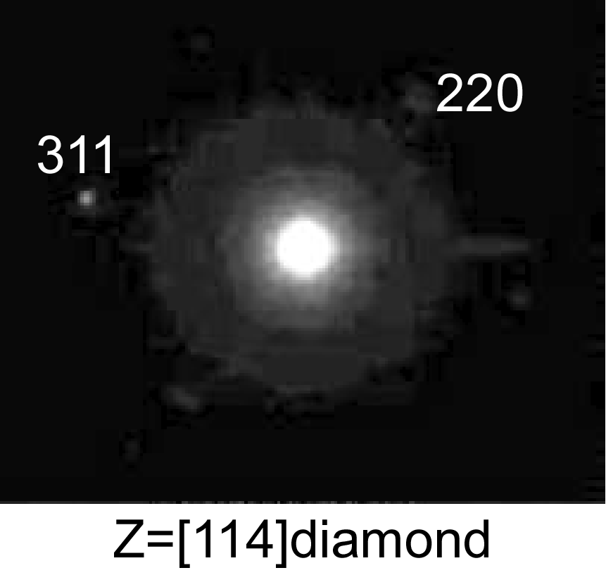
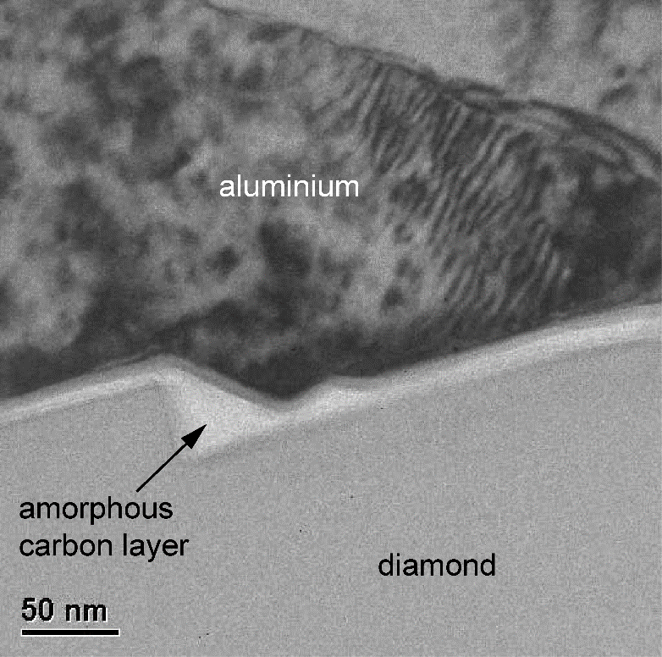
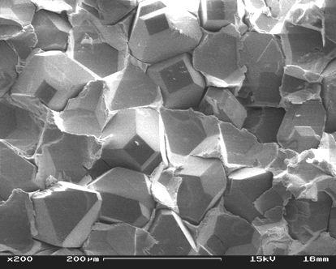
Development of high thermal conductivity Al/diamond MMCs
interface characteristics of squeeze cast Al99.99/diamond MMCs
1. amorphous interfacial carbon layer
2. weak interfacial bonding
F.A. Khalid, O. Beffort, U.E. Klotz, B. Keller, P. Gasser, Diamond and Related Materials 13 (2004), 393-400
O. Beffort, F.A. Khalid, L. Weber, P.W. Ruch, U.E. Klotz, S. Meier, S. Kleiner; Diamond and Related Materials 15 (2006)

Slide 20
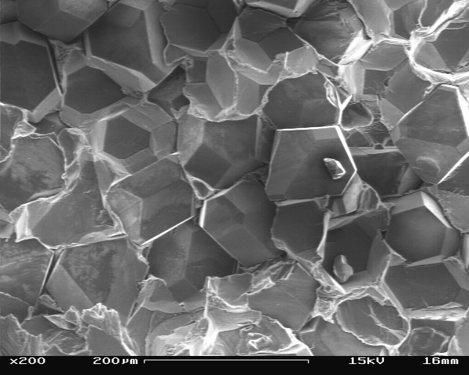
Development of high thermal conductivity Al/diamond MMCs
effect of Si-addition on interface formation in squeeze cast Al/diamond
goal: improve interfacial bonding by SiC formation
1. successful distribution of Si at the Al/diamond interface (segregation)
2. but: still weak interfacial bonding
O. Beffort, F.A. Khalid, L. Weber, P.W. Ruch, U.E. Klotz, S. Meier, S. Kleiner; Diamond and Related Materials 15 (2006)

Slide 21
Thermal Conductivity Analysis of Al(Si)/diamond using the Hasselman - Johnson Equation
Al/diamond, with
a = 50 μm
h = 8·10⁷ W/m²·K
⇒ B = 0.45
Al/diamond, with
a = 50 μm
h = 1·10⁶ W/m²·K
⇒ B = 36
AlSi7/diam.
squeeze casting
Al/diam.
squeeze casting
λ_{r} = 1800 W/m·K for diamond

Slide 22
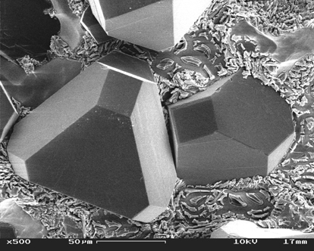
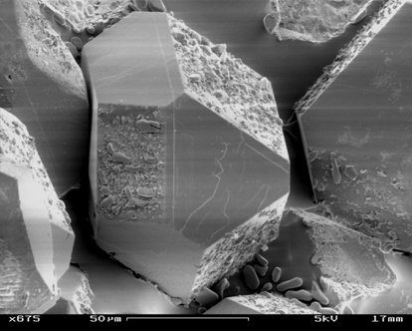
Development of high thermal conductivity Al/diamond MMCs
effect of infiltration technique on interface formation in AlSi7/diamond
after electrochemical dissolution of Al
1. squeeze cast composite
bare diamonds, unaffected
2. gas pressure infiltrated composite
selective reaction on diamond₍₁₀₀₎
P.W. Ruch, Diploma Thesis, EMPA, 2005

Slide 23
Thermal Conductivity Analysis of Al(Si)/diamond using the Hasselman - Johnson Equation
Al/diamond, with
a = 50 μm
h = 8·10⁷ W/m²·K
⇒ B = 0.45
AlSi7/diam.
gas pressure
infiltration
Al/diamond, with
a = 50 μm
h = 1·10⁶ W/m²·K
⇒ B = 36
AlSi7/diam.
squeeze casting
Al/diam.
squeeze casting
λ_{r} = 1800 W/m·K for diamond

Slide 24
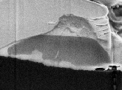
Development of high thermal conductivity Al/diamond MMCs
characterisation of interface reaction products in AlSi7/diamond
EDX linescan across diamond/metal interface
no direct contact between Si and diamond; no SiC detected !
⇒ role of Si ??
P.W. Ruch, Diploma Thesis, EMPA, 2005

Slide 25
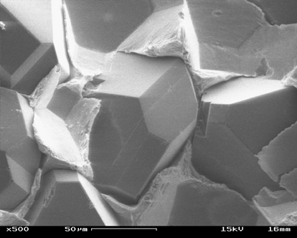
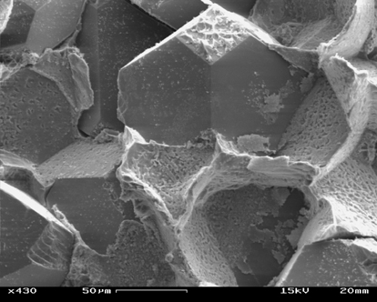
High thermal conductivity Al/diamond MMCs
effect of infiltration technique on interfacial bonding in Al/diamond
squeeze casting vs gas pressure infiltration
1. squeeze cast composite
weak interfacial bonding
2. gas pressure infiltrated composite
enhanced interfacial bonding
O. Beffort, F.A. Khalid, L. Weber, P.W. Ruch, U.E. Klotz, S. Meier, S. Kleiner; Diamond and Related Materials 15 (2006)
P.W. Ruch, O. Beffort, S. Kleiner, L. Weber, P.J. Uggowitzer; Composites Science & Technology 66 (2006)

Slide 26
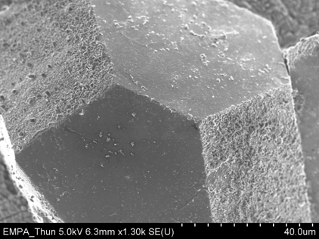
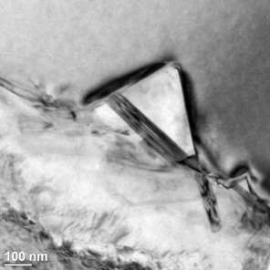
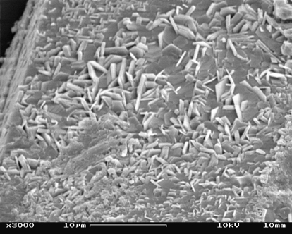
interface formation in Al/diamond MMCs
selective reaction on diamond₁₀₀
gas pressure infiltration, as-received diamonds
(111)
Diamond
(100)
(100)
(111)
Al
Al₄C₃
S. Kleiner, F.A. Khalid, P.W. Ruch, S. Meier, O. Beffort, Scripta Mat 55 (2006)
Notes:
The reactivity of diamond with liquid aluminium is very distinct for the {10 0} and {111} faces. Whereas the {111} faces are barely attacked by contact with liquid aluminium, the {100} surface atoms are easily dissolved and participate in the formation of interfacial carbides. This behaviour is attributed to the different bonding arrangement of the surface atoms. Liberation of the three-fold bonded {111} surface atoms is much more difficult than the dissolution of the two-fold bonded {100} surface atoms. Dissolution of carbon results in jagged {100} diamond surfaces, which feature a characteristic morphology with pits and/or pyramids. The faces of these pits and pyramids are crystallographic {111} planes. The development of such a surface morphology can be explained by the effect of dissolutionresistant small surface areas. By providing a third bond to the underlying atoms, these stable surface areas protect all the underlying atoms within a volume bounded by {111} faces. Best adhesion between the aluminium matrix and the diamond {100} faces is obtained when the interface is covered by individual carbide platelets which do not completely prevent direct aluminium–diamond contact. Thicker, continuous carbide layers cannot provide good bonding between diamond and aluminium.

Slide 27
Thermal Conductivity Analysis of Al/diamond using the Hasselman - Johnson Equation
Al99.99/diam.
gas pressure
infiltration
h = 1.8·10⁸ W/m²K
Al/diamond, with
a = 50 μm
h = 8·10⁷ W/m²·K
⇒ B = 0.45
AlSi7/diam.
gas pressure
infiltration
Al/diamond, with
a = 50 μm
h = 1·10⁶ W/m²·K
⇒ B = 36
Al(Si7)/diam.
squeeze casting
λ_{r} = 1800 W/m·K for diamond
Notes:
It has been found that improved interfacial bonding and thermal conductivity (up to 670 W/mK) can be achieved in diamond/aluminium composites made by gas pressure infiltration, which is related to the formation of Al₄C₃ at the interface. However, the reactivity of synthetic cube-octahedric diamond single crystals with liquid Al is very distinct for the different diamond faces; while the {111} faces are barely attacked by Al, the {100} surface atoms are easily dissolved and react to Al₄C₃. The higher reactivity of the {100} faces compared to the {111} faces is associated to the different atomic bonding of carbon on these crystallographic faces: the two-fold bonded atoms of the {100} surface are more easily liberated to engage in carbide formation than the three-fold bonded atoms of the {111} surfaces.

Slide 28
metal diamond bonding
Strong bonding and high interfacial thermal conductance can be achieved if the alloy has some affinity to diamond
Al is able to form a carbide (Al₄C₃) chemical bonding possible
Methods to improve the diamond-metal bonding are based on:
- modification of the matrix metal
● (micro)alloying with a strong carbide former
- modification of the diamond:
● increase the surface roughness
● increase the surface reactivity
● coating of the diamonds with a carbide forming metal

Slide 29
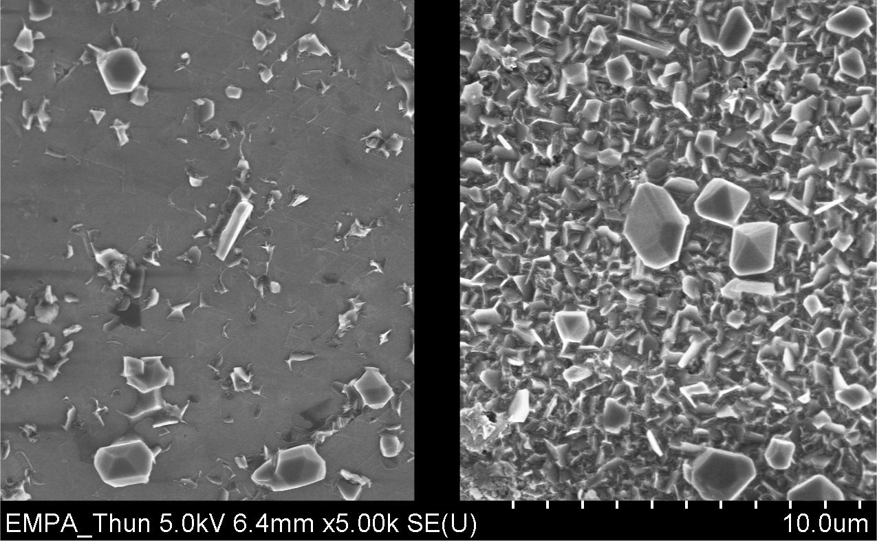
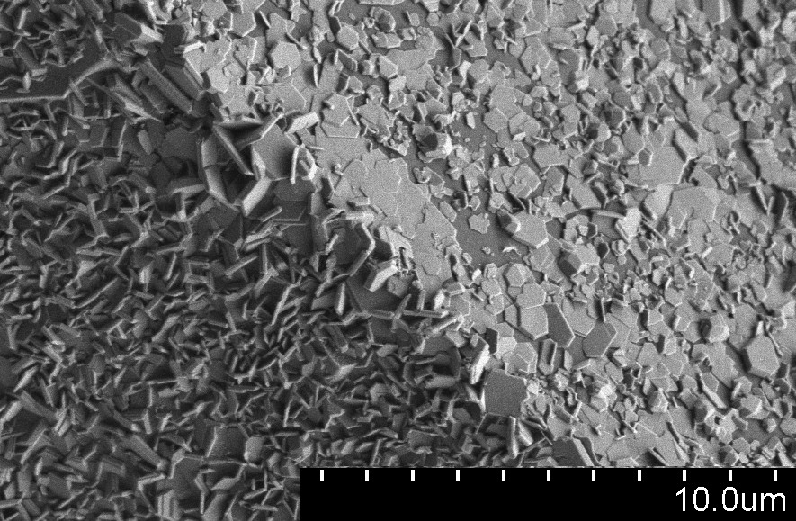

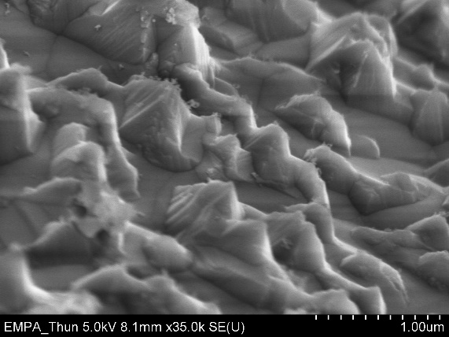
interface formation in Al/diamond MMCs
effect of diamond surface activation
(111)
(100)
(100)
(111)
Double bonded (100) surface atoms can more easily be liberated to participate in carbide formation than triple bonded (111) surface atoms
An appropriate surface treatment (e.g. thermal etching) can activate the (111) surface
Notes:
Best adhesion between the Al matrix and the diamond {100} faces is obtained when the interface is covered by individual carbide platelets which do not completely prevent direct aluminium-diamond contact. Thicker, continuous carbide layers fail to provide good bonding between diamond and Al and are thus not desirable.

Slide 30
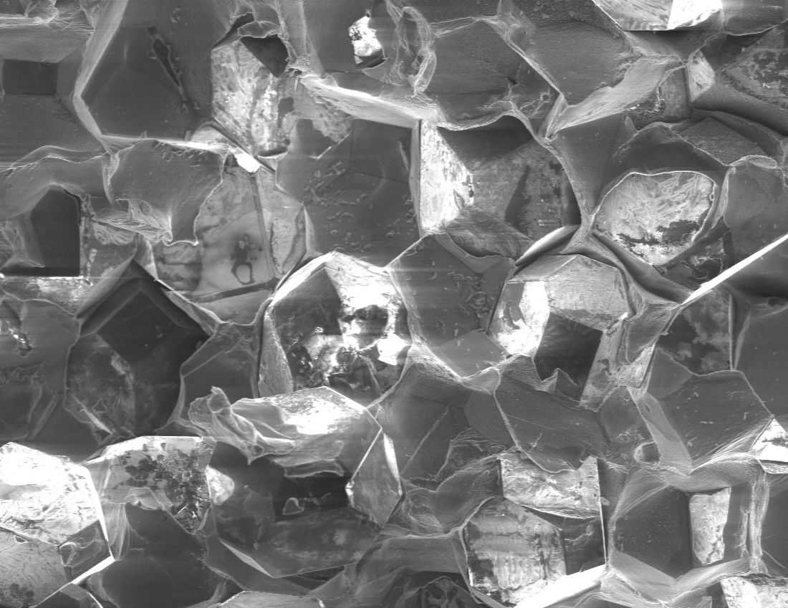
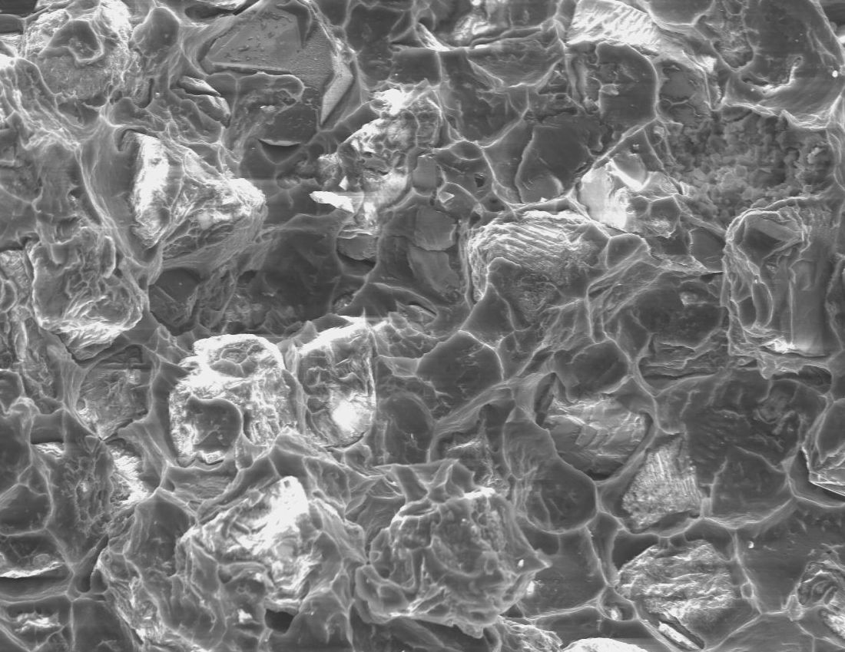
interfacial bonding in Al/diamond MMCs
effect of diamond surface activation
Brittle fracture along the diamond-aluminium interfaces
(as received diamond, weak bonding)
Ductile fracture mainly through the aluminium matrix
(surface-activated diamond, strong bonding)

Slide 31
Conclusions
Al/diamond composites can be made by pressurised melt infiltration without deterioration of the diamond phase
the thermophysical properties of these composites are determined by the interface characteristics
a strong interface is required
the interface formation is influenced by
    - processing conditions
- surface treatments
- constituents chemistry
⇒ After fine tuning Al/diamond composites with thermal conductivity > 600 W/mK can be achieved.

